Slide 1
Designing of Drone for capturing of VJIT and analysing its live video using Deep Learning Framework
VIDYA JYOTHI INSTITUTE OF TECHNOLOGY (Autonomous)
Under the guidance of By
Dr. A. Obulesh J.Snigdha [19911A3521]
M. Yagnesh [19911A3531]
V.S.D Bharadwaj [19911A3552]

Slide 2
Abstract
Drone (Unmanned Aerial Vehicle) is an electronic device which is remote controlled based aircraft used to achieve vertical flight with stability and it can be used for capturing live Video and also for capturing images using camera.
The basic drone includes a frame, flight control board, motors, electronic speed controllers, a transmitter, a receiver, Lipo battery. Individual components were tested and verified. Tuning and calibration of the PID controller were done to obtain stabilization on each axis. Currently, the drone can properly stabilize itself.

Slide 3
Abstract
The drone provides a rare view of the campus to get complete information in and out with an analysis report. As drone is a movable aerial vehicle with integrated camera, it can reach blind spots easily and can improve surveillance
The data captured by drone is now classified by using Deep Learning YOLO V5 framework. This works by analysing the data into different categories such as vehicles (2 wheelers and 4 wheelers with owner name), pedestrians(Humans) and provides the count of each category

Slide 4
Introduction
Drone:-
Drone(UAV) is defined as an Unmanned Aerial Vehicle that does not carry a human operator, uses aerodynamic forces to provide vehicle lift, can fly autonomously or be piloted remotely. It is controlled either autonomously by on-board computers or by remote control of a pilot on the ground.
A Drone has been built that can be operated by radio frequency controller. Micro- controller based drone control system has also been developed where a RF transmitter and receiver operating in the frequency of 2.4 GHz are used for remote operation for the Drone.

Slide 5
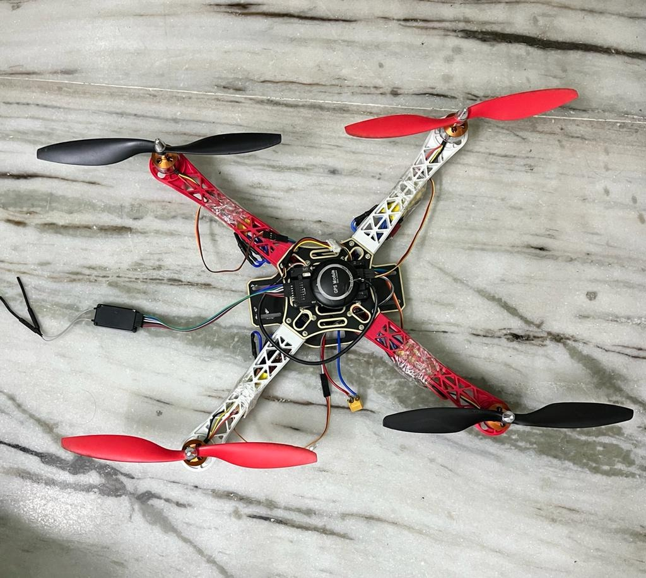
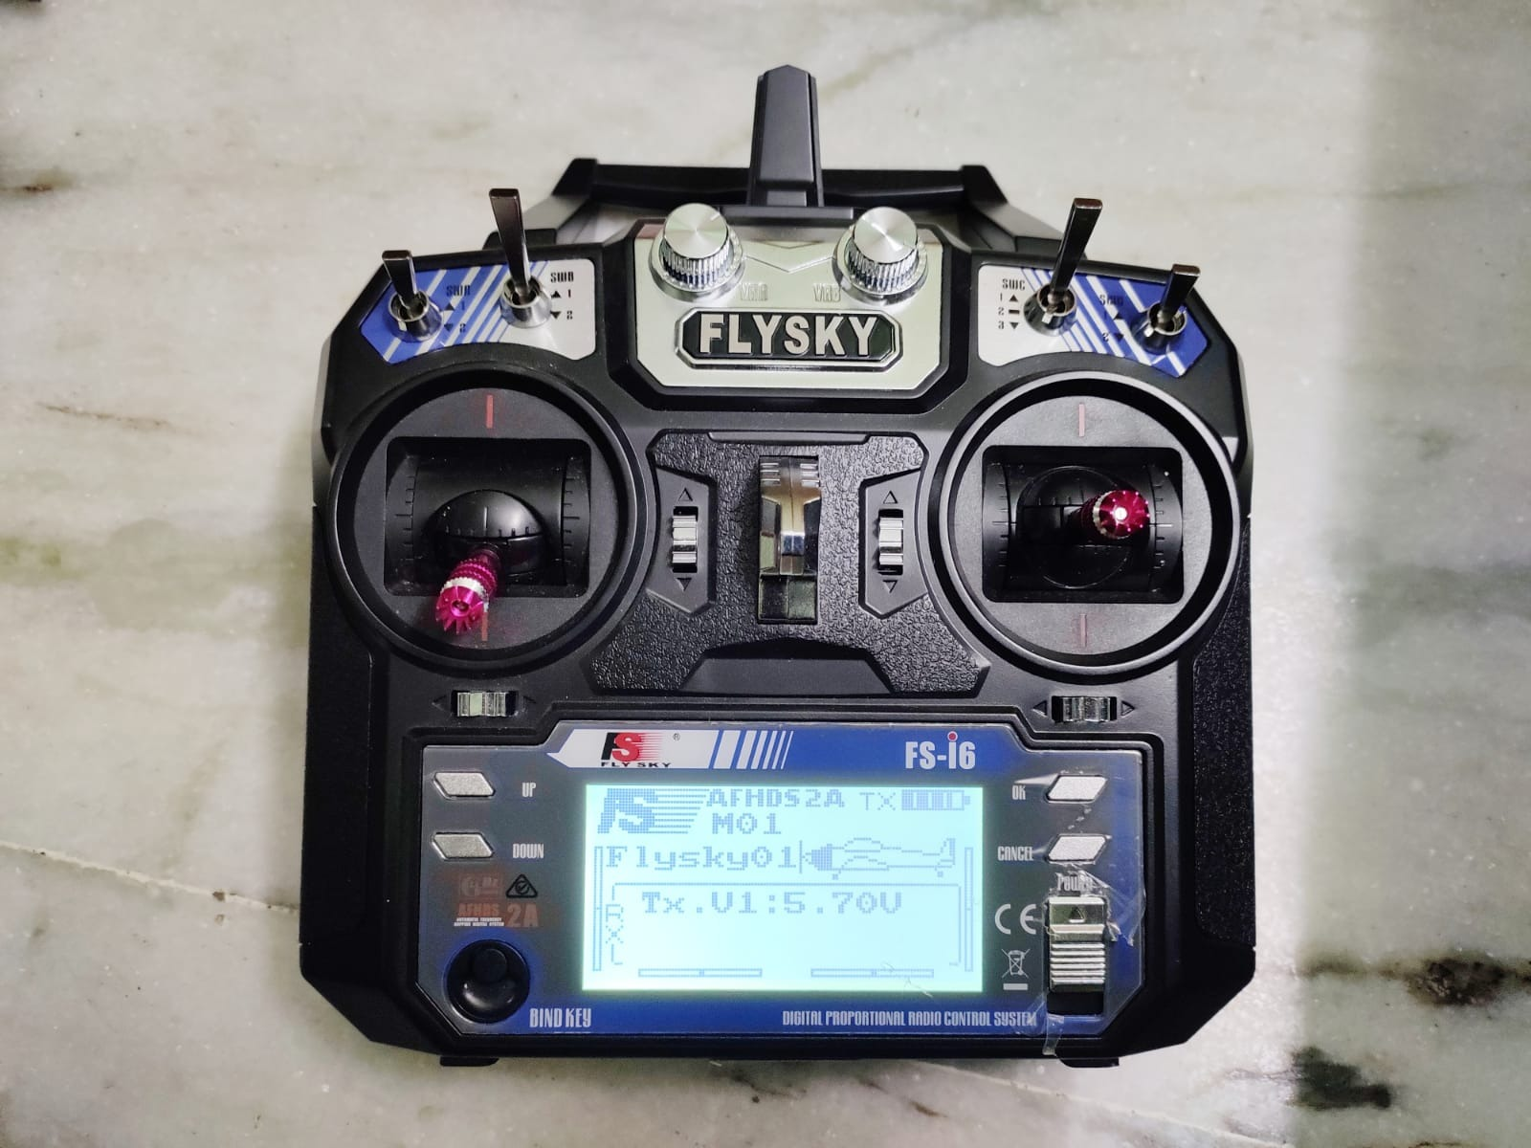
Introduction
The developed drone in this work can be used for a number of applications, such as shipping and delivery, Surveillance, Agricultural usage, Disaster management and many more.

Slide 6
Introduction
YOLO V5:-
YOLO (You Only Look Once) v5 is a real-time object detection system for identifying objects in images and videos. It uses a single neural network to predict bounding boxes and class probabilities for objects in an image, allowing it to process images efficiently in real-time.
YOLO v5 has improved accuracy compared to previous versions and is capable of detecting objects in high-resolution images. It is widely used in various applications such as self-driving cars, surveillance systems, and sports analysis.

Slide 7
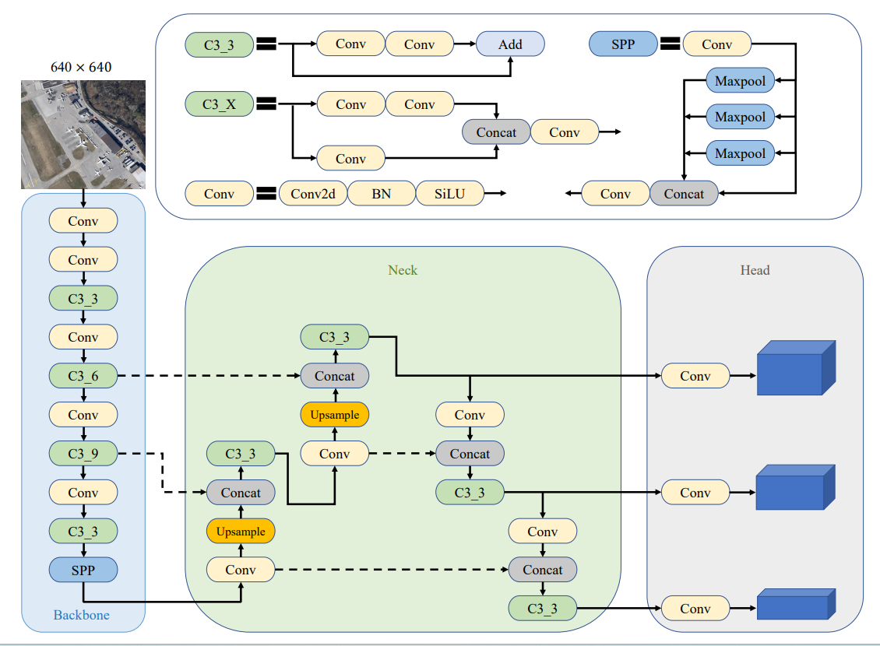
YOLO v5 Architecture Diagram

Slide 8
Literature Survey
Guide to Designing, Constructing,and FlyingYour Very Own Drone,Author Barry Davies has built drones for DARPA (Defense Advanced Research Projects Agency),2020
The novel development and designs from traditional Quadrotors to Tiltrotors or Tilt-wings is becoming the new trend where many authors and research groups are focused towards practically implementing these systems within many outdoor applications. In fact, it is believed that any mechanical development of traditional Quadrotors is becoming a focus in the literature, especially those that are mechanically modified to structurally change during flight.

Slide 9
Existing System
According to previous studies, many control techniques are being implemented on robotics systems today. With regard to Quadrotors, each control algorithm has a unique method of implementation where some are linear while others are non-linear.
There are many aerial vehicles which can record and capture through integrated cameras basically used for surveillance purpose only.

Slide 10
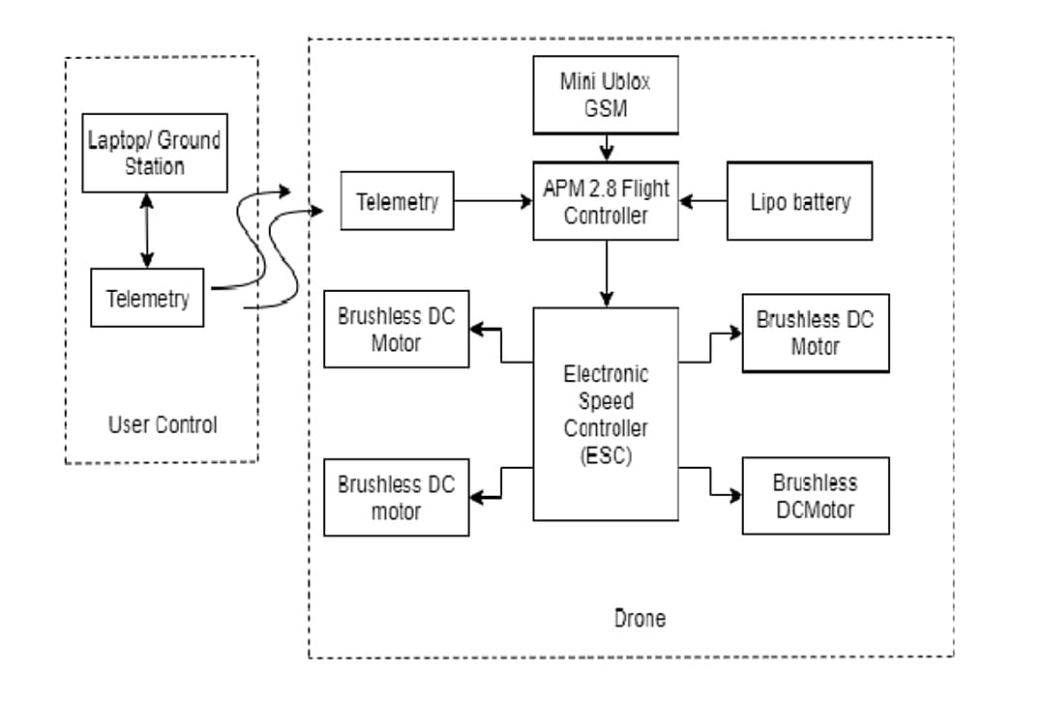
Work Flow diagram

Slide 11
Proposed system
As there are many exisiting systems which are only used for surveillance
In this project we are trying to develop a drone that can perform live video analysis by categorizing humans and vehicles by providing the count, additionally our model can recognize the vehicle type and gives their owners names on display.
For live analysis and recognition we used a Deep Learning framework YOLO(You Only Look Once) V5

Slide 12
Frame Division Methodology
Line classification: This method involves identifying straight lines in an image and classifying them based on their properties, such as length, orientation, and position. Line classification is commonly used in object recognition, where identifying lines can help in identifying the object's shape and orientation.
Hexagon classification: This method involves identifying hexagonal shapes in an image and classifying them based on their properties, such as size, orientation, and position. Hexagon classification is commonly used in pattern recognition and feature extraction, where identifying hexagons can help in identifying unique features of an object.
Rectangle classification: This method involves identifying rectangular shapes in an image and classifying them based on their properties, such as size, orientation, and position. Rectangle classification is commonly used in object detection, where identifying rectangular shapes can help in identifying objects of interest and their bounding boxes.

Slide 13
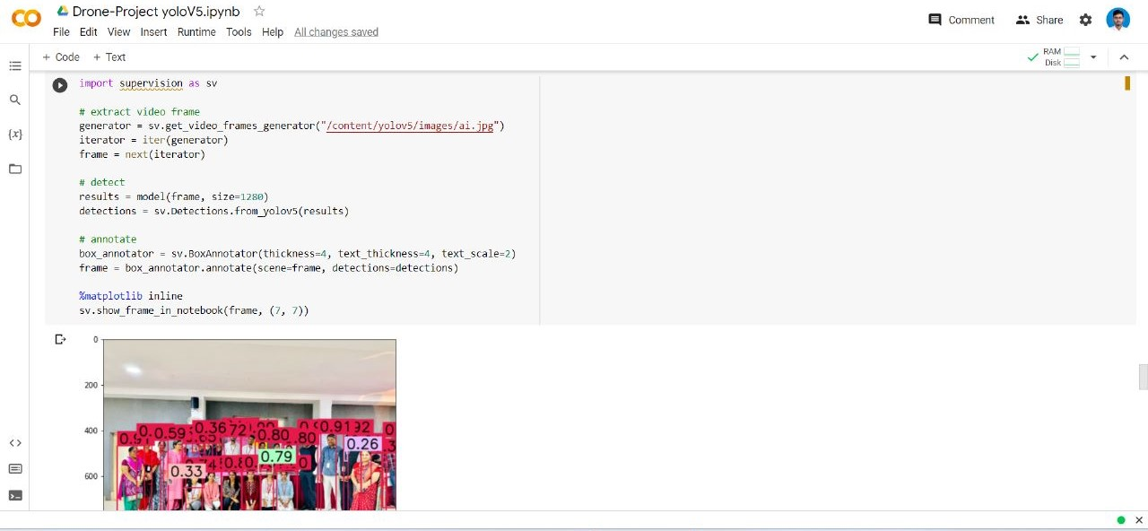
Code Snippet and Output

Slide 14
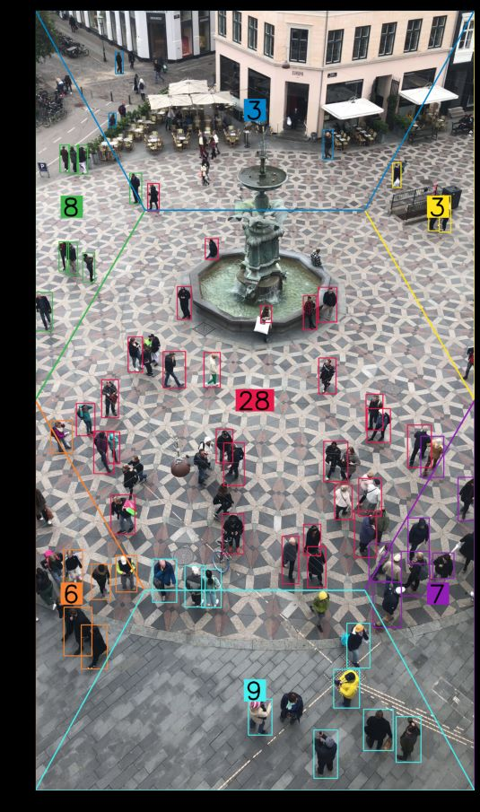
Hexagon Image Classification Output Cont….

Slide 15
Code Snippet and Output Cont….
video_info = sv.VideoInfo.from_video_path("/content/yolov5/images/ai.jpg")
zones = [
sv.PolygonZone(
polygon=polygon,
frame_resolution_wh=video_info.resolution_wh
)
for polygon
in polygons
]
zone_annotators = [
sv.PolygonZoneAnnotator(
zone=zone,
color=colors.by_idx(index),
thickness=4,
text_thickness=8,
text_scale=4
)
for index, zone
in enumerate(zones)
]
box_annotators = [
sv.BoxAnnotator(
color=colors.by_idx(index),
thickness=4,
text_thickness=4,
text_scale=2
)
for index
in range(len(polygons))
]
# extract image frame
generator = sv.get_video_frames_generator("/content/yolov5/images/ai.jpg")
iterator = iter(generator)
frame = next(iterator)
# detect
results = model(frame, size=1280)
detections = sv.Detections.from_yolov5(results)
detections = detections[(detections.class_id == 0) & (detections.confidence > 0.5)]
for zone, zone_annotator, box_annotator in zip(zones, zone_annotators, box_annotators):
mask = zone.trigger(detections=detections)
detections_filtered = detections[mask]
frame = box_annotator.annotate(scene=frame, detections=detections_filtered)
frame = zone_annotator.annotate(scene=frame)
%matplotlib inline
sv.show_frame_in_notebook(frame, (11, 11))

Slide 16
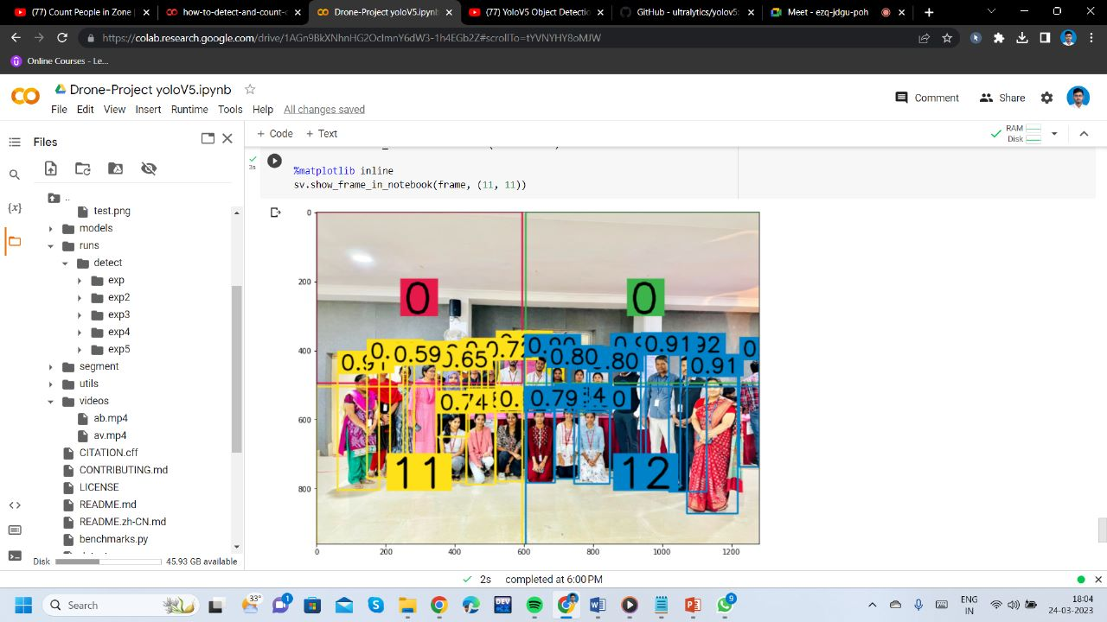
Zone Classification Output

Slide 17
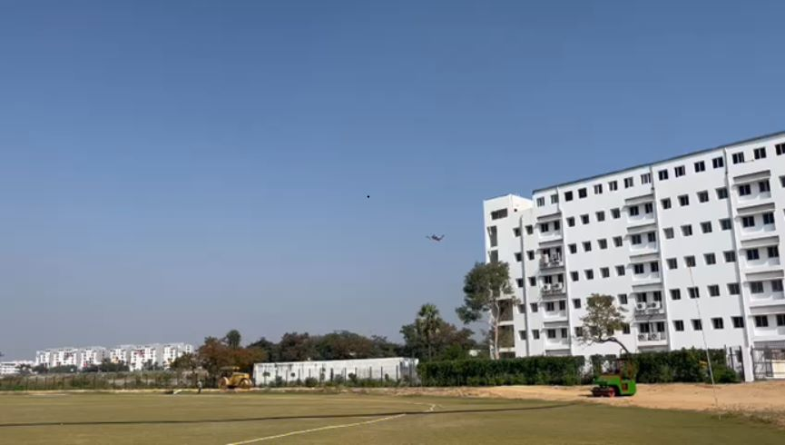
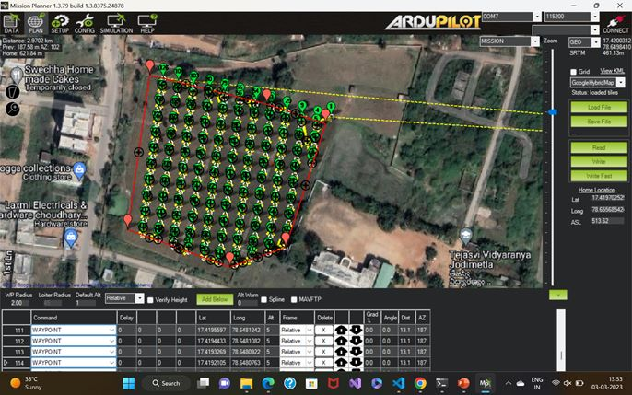
Final Output

Slide 18
